Slide 1
Information retrieval/ search engines
By
Nupur Kulkarni
631402325

Slide 2
Introduction
What is Information Retrieval ?
Information retrieval (IR) is the activity of obtaining information resources relevant to an information need from a collection of information resources.
Information retrieval is the science of searching for information in a document, searching for documents themselves, and also searching for metadata that describe data, and for databases of texts, images or sounds.
Search Engines
Automated information retrieval systems are used to reduce what has been called information overload. Many universities and public libraries use IR systems to provide access to books, journals and other documents. Web search engines are the most visible IR applications.

Slide 3
Overview
An information retrieval process begins when a user enters a query into the system.
Queries are formal statements of information needs, for example search strings in web search engines.
In information retrieval a query does not uniquely identify a single object in the collection. Instead, several objects may match the query, perhaps with different degrees of relevancy.
An object is an entity that is represented by information in a content collection or database. User queries are matched against the database information. However, as opposed to classical SQL queries of a database, in information retrieval the results returned may or may not match the query, so results are typically ranked. This ranking of results is a key difference of information retrieval searching compared to database searching.
In this presentation I am trying to explain 2 IR based search engines using different algorithms for searching and pros and cons of each search technique.

Slide 4

Example 1- AltaVista
AltaVista was created by researchers at Digital Equipment Corporation's Network Systems Laboratory and Western Research Laboratory who were trying to provide services to make finding files on the public network easier.
AltaVista was one of the most-used early search engines, but lost ground to Google and was purchased by Yahoo! in 2003.
Query searched: Justice League

Slide 5
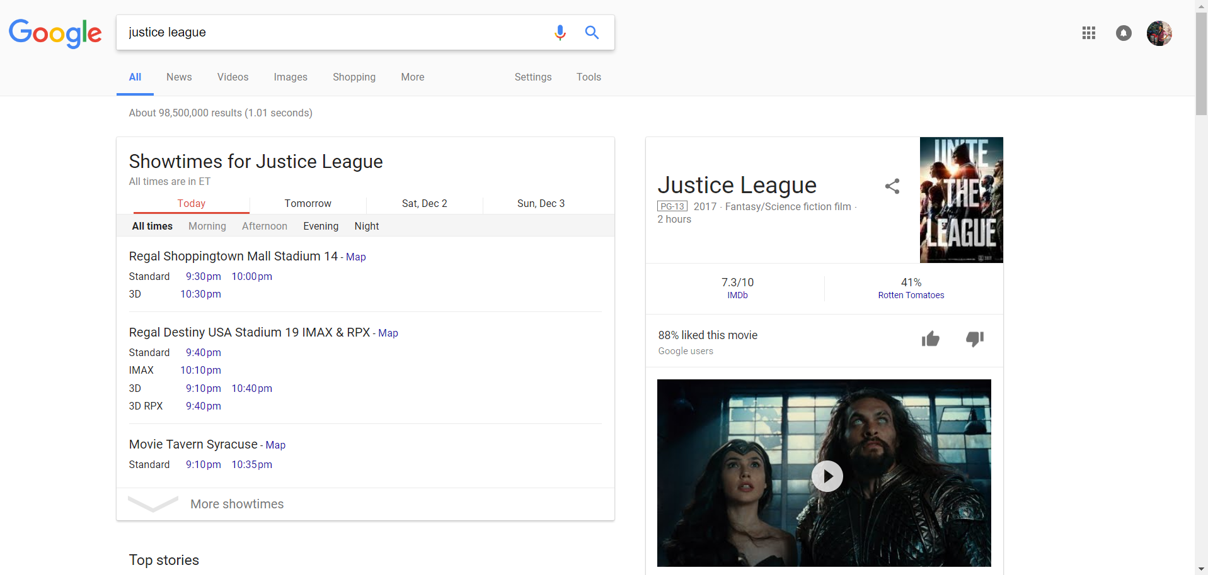
Example 2- Google Search
Google Search, commonly referred to as Google Web Search or simply Google, is a web search engine developed by Google. It is the most-used search engine on the World Wide Web, handling more than three billion searches each day. As of February 2016, it is the most used search engine in the US with 64.0% market share.
Query searched: Justice League

Slide 6
Comparison between AltaVista and Google Search
Notable results found after querying both search engines:
AltaVista was able to find only 3,360,000 results for the query Justice League where as Google Search found about 98,500,000 results in 1.01 seconds.
Google was good because there were no annoying advertisements on the search engine, whereas AltaVista had ads scattered in its pages.
The search results for what I was looking for were best found by Google because that referenced me to pages containing Justice League movie reviews and ticket booking. AltaVista provided a helpful search suggestion link to help narrow my topic down to something closer to my topic.
Debuting in 1999, Google is a one of the largest and most efficient search engines. Google is among the most innovative of all the search engines in terms of searches for relevancy. Much of its popularity comes from the fact that displays only the most pertinent links for a given topic by using link analysis. A unique feature that Google has over other search engines is that it has a special cache feature that allows you to access a site from cache if that site is either down or no longer available.
Debuting in 1995, AltaVista is one of the oldest and reputable search engines. Much of its popularity comes from the fact that it boosts a very large full-text database. AltaVista was the first search engine to store every word of every page on the entire Internet in a fast, searchable index. It also was the first search engine to support multi-language searches and the ability to translate sites from one language to another.

Slide 7
Comparison between AltaVista and Google Search
While comparing these two search engines, many similarities and differences can be observed. The first notable comparison is the method in which each of these search engines carries out searches. Google uses an automatic AND Boolean search and an optional OR Boolean search. It does not yet support the AND operator, NOT operator, or full Boolean searching with the ability to nest operators. It was also the first to introduce - a NOT search option. Google has stop words, but has the ability to search with stop words if needed. AltaVista uses a default OR Boolean search option and has the options +, -, AND, OR, AND NOT, and (). AltaVista can use full Boolean searching as well as nested searches using parentheses. AltaVista does not have any stop words.
Other similarities between Google and AltaVista include proximity searching, case sensitivity, fields searching, and sorting. Proximity searching refers to how close words should be when searching phrases. Both of the search engines use phrase matching, which looks for phrases in the exact order that they are entered in the search. Case sensitivity refers to the ability of the search engine to search all cases in both topic entry and search results. Both of the search engines are case insensitive. Fields searching is the ability to define from where a search comes from instead of searching the entire Internet. Both of the engines allow for field searching. Sorting is the ability to organize the results of the search. Both of the search engines sort by relevance to the search topic.
Differences between these search engines include truncation and their limitations. Truncation refers to the ability of the search engine to search for just a portion of a word by using an asterisk to signify the rest of the word. Google do not permit truncation searches, however, AltaVista does. Limitations between these two search engines differ greatly as well. Google has language, domain, date, filetype, and adult content limits. AltaVista has language limits and the option of date limits.

Slide 8
Comparison between AltaVista and Google Search
Comparison at a glance:
Search Engine | Boolean | Proximity | Truncation | Case | Fields | Stop words | Limitations | Sorting
Google | -, OR | Phrase | No | No | Yes | Yes | Language , Domain, Filetype, Date, Adult Content | Relevance
AltaVista | +, -, AND, OR, AND NOT, ( ) | Phrase | Yes | No | Yes | No | Language, Date | Relevance

Slide 9
References
http://homepage.univie.ac.at/juan.gorraiz/Vortrag/altavista3.html
https://en.wikipedia.org/wiki/AltaVista
https://en.wikipedia.org/wiki/PageRank
https://en.wikipedia.org/wiki/Full-text_search
https://searchenginewatch.com/sew/news/2047405/how-altavista-works
Books:
Search Engines Information Retrieval in Practice
https://dl.acm.org/citation.cfm?id=1516224

Slide 10
Thank You!

